Slide 1
Google Earth Initiative
William Ganley, James Warner, Michael Shimony

Slide 2
Background
Initiative task to investigate Google Earth
Standalone application versus browser plug-in
Standalone application uses COM API
Support ended in 2008 with the release of browser plug-in
Browser plug-in
JavaScript API
Plug-in supports
Windows (XP and Vista)
Mac OS X 10.5 and higher
Requires Internet connection for API
Google Earth is free for personal use
Google Earth Pro requires paid license for commercial uses
MSE Initiative used the free version

Slide 3
Pros and Cons
Pros
Easy to use
Robust API
Excellent documentation
https://developers.google.com/earth/documentation/reference/
Many examples online
Can use Google Maps API inside Google Earth
GeoCoding locations, driving directions, etc.
KML support in API
Cons
Browser plugin support for Windows/Mac only
Requires internet connection
Cannot support real-time updates
Transaction limits
Free version has transaction limits
Google Earth Pro costs license $400/year

Slide 4
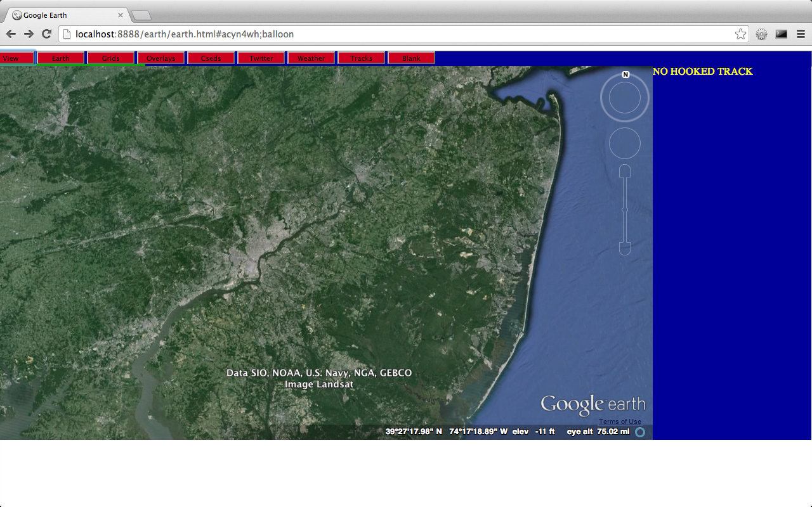
Prototype Design
Laptop running MAMP
MySQL
HTML/JavaScript/CSS
Apache Webserver
Ajax
PHP

Slide 5
Features explored under MSE Initiative
View Control
Offset view
Locations (name, address, position), tracks
Range in/out
Camera tilt
Google Earth built-in features
Sunlight/night coverage
Inset Map
Roads, borders, buildings, terrain, atmosphere
Earth/Sky map
Lat/Lon grid
Display of KML information
Downloaded KML files for many features

Slide 6
Features explored under MSE Initiative
Custom built features
Tracks
Mil-Std 2525B track symbols
Add/Modify/Delete by operator
Track Simulator
Symbol sizes
Track Tags
Track Filter (category and id)
Weather Feed
Twitter integration
Range rings

Slide 7
Demo

